Slide 1
CSSE 220
2D Arrays and Maps
The git projects for today are:
Practice2DArraysAndMaps
Practice2DArraysAndMapsSolution
Notes:
Note: You will want to use clicker for slides today!
Bring hard copy of code from 2DArraysAndMapsSolution.
Bring copies of 2DArraysAndMapsSamples from Instructor Resources.

Slide 2
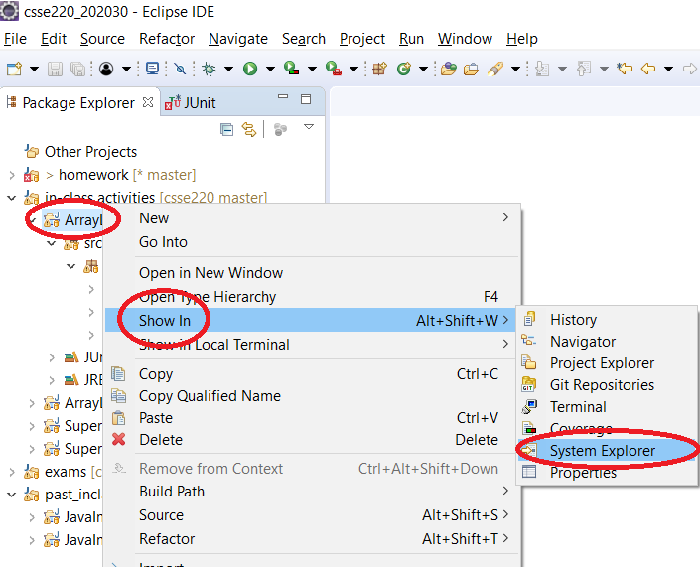
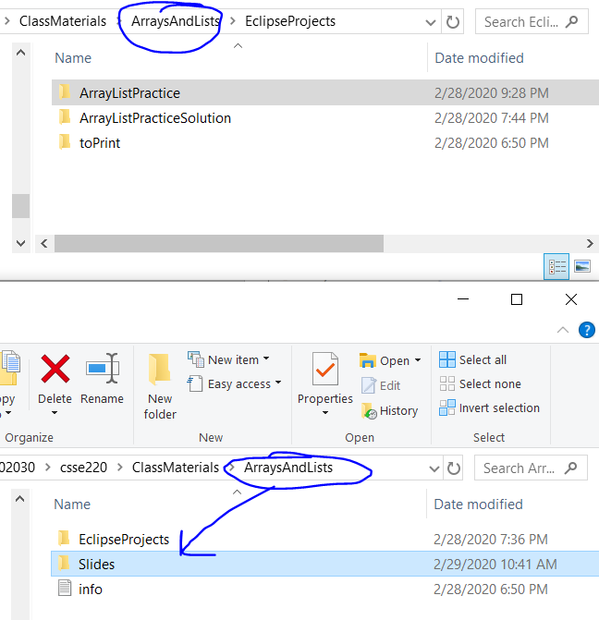
How to access slides (locally)

Slide 3
Today’s Agenda
Questions: Post to Piazza
Academic Honesty
Quizzes
Review:
Coding Gotchas
Enhanced for loops
2D Arrays
Maps
Notes:
Most time will be spent on the last two items

Slide 4
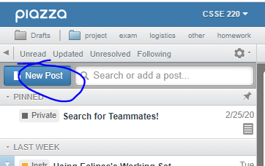
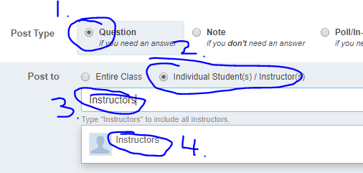
Questions: Post to Piazza
PLEASE Post All Questions to Piazza
If asking a question about an individual assignment (i.e. Homework) and you must share code (Homework) to ask your question:
Email instructors ONLY (see below)
Otherwise: please post questions and look to help provide hints to other students
Collaborative (i.e. in-class activities) or if you don’t have to post code to ask the question
Notes:
Emphasize to the students that if they feel overwhelmed they are not alone!
Remind them to ask questions and that as a class we can go slower if we need to.
As a rule: students really struggle with the enhanced for loop, if there are no questions, people may be scared to ask.
Other topics student are likely to be confused at this point:
different between primitives and classes/objects
the idea that memory stores information somewhere and it effectively is an address (null) for objects
public vs. private: could create a little demo class (Person) to show getter and setters with private/public variables (name)
Person p1 = new Person(“Jason”); p1.name p1.getName()

Slide 5
Quizzes
There will be an online quiz associated with almost every lecture
Available on Moodle
Must be completed by 23:55pm EST on the Sunday the week of the lecture
You can post questions relating to this on Moodle even sharing your code

Slide 6
Academic honesty in CS
Please do not collaborate on homework assignments beyond what is allowed
Definitely not OK
Looking at someone else’s solution, “just for a reference” as you write your own code
Pair programming on an individual assignment
Sitting next to someone as you both work on the assignment, working through any problems you have as a group
Notes:
When individual assignment, pair programming is not allowed!

Slide 7
How much help is too much help?
“So you loop across the array elements, getting each element and seeing if it’s in the hashtable. If it is, you get the value and increment it…”
Borderline but OK
“So you write a for loop, 1 to array length. Your key variable is gonna be array[i]. You check if hashMap.get(key) is null, if not, you get the value with get, then hashMap.put(key, oldValue + 1)…”
Giving away the answer. Cheating.
Notes:
More vague than top OK
Less vague than bottom, NOT OK!

Slide 8
Penalties – they are severe
Automatic F in the course
Drop 1 letter grade
-100% score on assignment
Yes, you can get an automatic F for cheating on one assignment one time.
You should always credit anyone you get help from on an assignment. If you do, it lets me assign one of the weaker penalties.
Notes:
Exam, just immediately F
Worse than a 0% actually negative 100%
1 or 2 lines from stackoverflow is ok, but not 8-10
Its ok to ask for help when you have one small thing.
Unlimited help with Eclipse Git tools etc

Slide 9
Questions about Academic Integrity Policy
Feel free to post questions to Piazza relating to academic honesty between now and next class
For example:
Is it OK if I do ___?
Why are we not allowed to do ___?
What should I do if ____?
Notes:
Make them ask questions (at least one) about academic honesty policy before moving on
Explain the reasoning behind the academic honesty policy:
Students need to learn competency, too much help does not prepare them for future courses or career

Slide 10
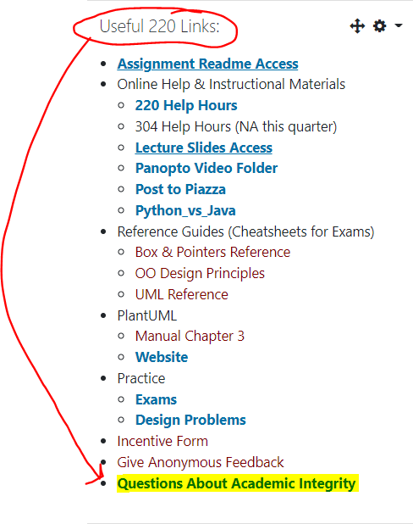
Today’s Handout
Is available digitally if you ever lose it

Slide 11
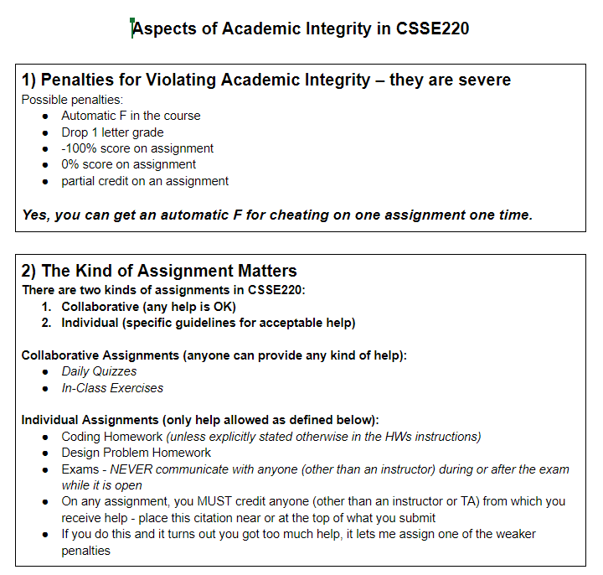

Slide 12
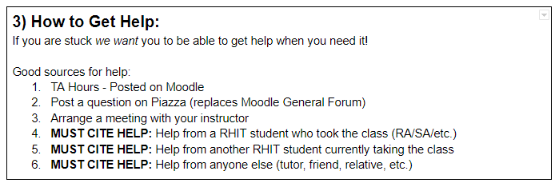
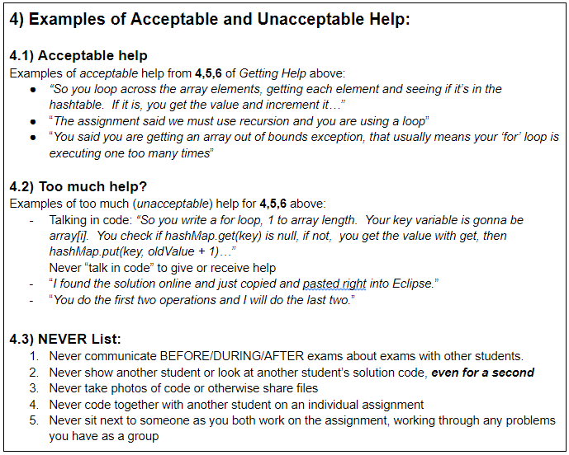

Slide 13
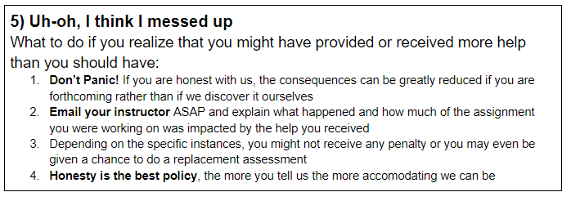
Ask me a question about a “gray area” right now!

Slide 14
Today’s Agenda
Questions: Post to Piazza
Academic Honesty
Quizzes
Review:
Coding Gotchas
Enhanced for loops
2D Arrays
Maps
Notes:
Most time will be spent on the last two items

Slide 15
Coding Gotchas – the size of things
int[] numbers = { 2, 4, 8, 16};
int numbersCount = numbers.length;
// Java array uses 'length'
ArrayList<String> words = new ArrayList<String>();
words.add("Hello!");
int wordsCount = words.size();
// ArrayList uses 'size()'
String word = "Hello";
int characterCount = word.length();
// String uses length()

Slide 16
Enhanced For Loops
Convenient Syntax
for iterating through collections
More readable
Less Typing
Less Error Prone
Works for Arrays, ArrayList, Map (later)
Similar to Python:
for num in nums:

Slide 17
Enhanced For Loop and Arrays
Old school double[] scores = … double sum = 0.0; for (int i = 0; i < scores.length; i++) { sum += scores[i]; } // end for
New, whiz-bang, enhanced for loop double[] scores = … double sum = 0.0; for (double score : scores) { sum += score; } // end for
No index variable (easy, but limited in 2 respects)
Gives a name (score here) to each element
Say “in”
Notes:
Call-outs animated
Like python’s “for num in nums:”
Convenient when we just need to iterate over the objects.
The two limitations:
We CAN’T USE the indices.
We CAN’T MODIFY the element and stick it back in the array. CONCURRENT MODIFICATION EXCEPTION!

Slide 18
Enhanced For and ArrayList’s
ArrayList<State> states = new … int total = 0; for (State oneState : states) {
total += oneState.getElectoralVotes();
} // end for
State is a user defined class
getElectoralVotes() is a method in State which returns an int

Slide 19
Begin 2D Arrays Part of Today’s Discussion

Slide 20
2D Arrays – What, When, Why, How?
What:
Think of them as an array of arrays
… or as a grid with rows & columns
When:
Represent 2 dimensional data
Game Boards
Tables
Multiple lists of items
Etc.
Notes:
What does it mean when I write down?
int[] (an array of type int)
OR
___[] (an array of some? type )
Is int[] a type? yes
What is does this mean?
int[][] (an array of int arrays!)

Slide 21
2D Arrays – What, When, Why, How?
Why:
Match your data representation as closely as possible to the real-world
How:
char[][] ticTacToe = new char[3][3];
Retrieving data
ticTacToe[0] → Gets the first char[]
ticTacToe[1][2] →Gets the second array’s third item

Slide 22

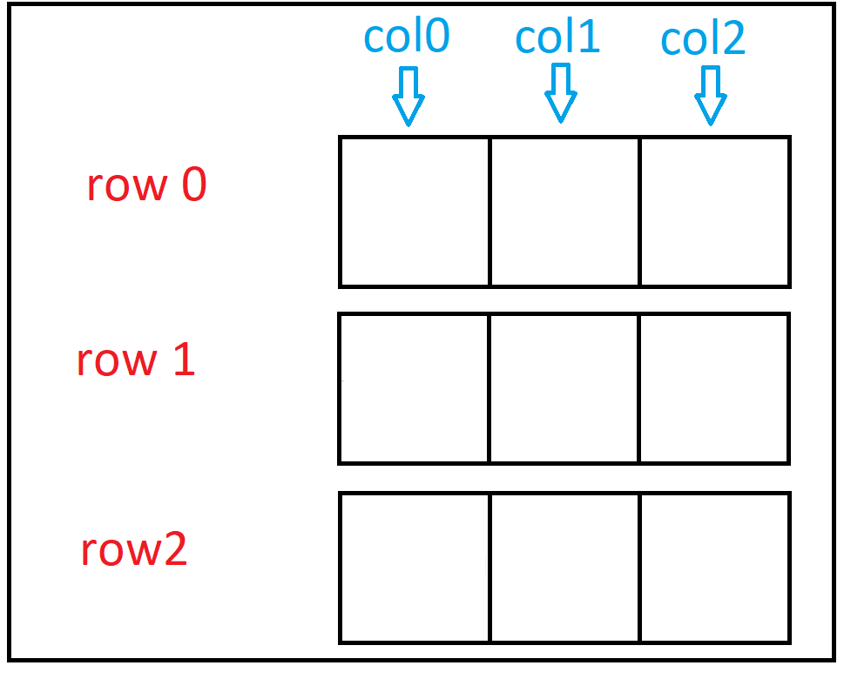
Creating a 2D char array

Slide 23
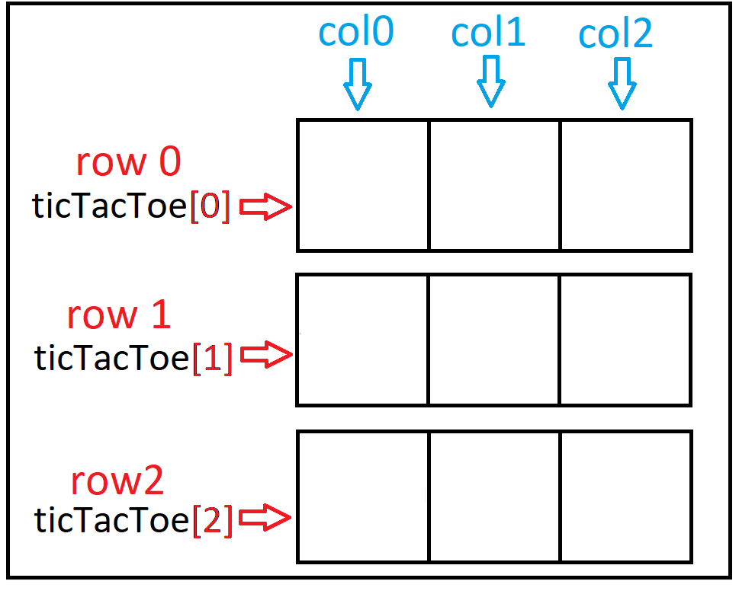
Creating a 2D char array

Slide 24
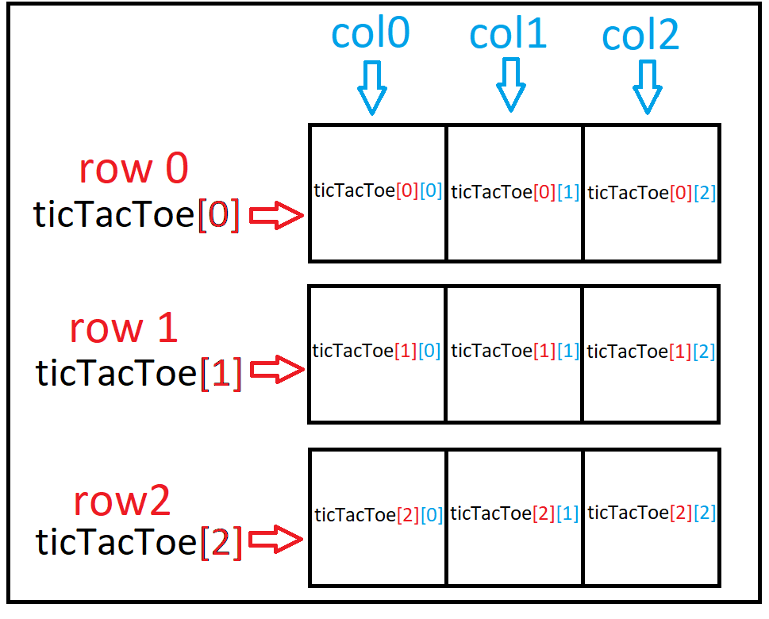
Creating a 2D char array

Slide 25
Creating a 2D char array
ticTacToe[ row ] [ column ] -> refers to individual cell

Slide 26
Creating a 2D char array
ticTacToe[ 1 ][ 1 ] = ‘X’;

Slide 27
Creating a 2D char array
ticTacToe[ 1 ][ 1 ] = ‘X’;
X

Slide 28
Creating a 2D char array
ticTacToe[ 0 ][ 1 ] = ‘O’;
X

Slide 29
Creating a 2D char array
ticTacToe[ 0 ][ 1 ] = ‘O’;
O
X

Slide 30
Creating a 2D char array
ticTacToe[ 2 ][ 2 ] = ‘X’;
O
X

Slide 31
Creating a 2D char array
ticTacToe[ 2 ][ 2 ] = ‘X’;
O
X
X

Slide 32
Creating a 2D char array
ticTacToe[ 0 ][ 0 ] = ‘O’;
O
X
X

Slide 33
Creating a 2D char array
ticTacToe[ 0 ][ 0 ] = ‘O’;
O
O
X
X

Slide 34
Creating a 2D char array
ticTacToe[ 2 ][ 0 ] = ‘X’;
O
O
X
X

Slide 35
Creating a 2D char array
ticTacToe[ 2 ][ 0 ] = ‘X’;
O
O
X
X
X

Slide 36
Creating a 2D char array
ticTacToe[ 2 ][ 1 ] = ‘O’;
O
O
X
X
X

Slide 37
Creating a 2D char array
ticTacToe[ 2 ][ 1 ] = ‘O’;
O
O
X
X
O
X

Slide 38
Creating a 2D char array
ticTacToe[ 0 ][ 2 ] = ‘X’;
O
O
X
X
O
X

Slide 39
Creating a 2D char array
ticTacToe[ 0 ][ 2 ] = ‘X’;
O
O
X
X
X
O
X

Slide 40
2D array dimensions
int[][] numArray = new int[2][4];
int rows = numArray.length;
int cols = numArray[0].length;

Slide 41
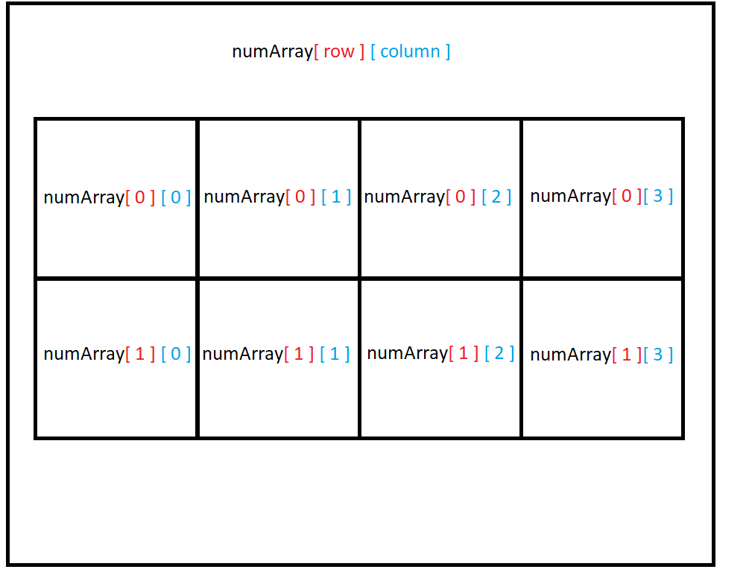
2D array dimensions
2 rows
4 columns

Slide 42
Iterate by rows through 2D array?
int[][] numArray = new int[2][4];
int rows = numArray.length;
int cols = numArray[0].length;
int count = 0;
for (int r = 0; r < rows; r++) {
for (int c = 0; c < cols; c++) {
numArray[r][c] = count;
count++;
} // end for
} // end for

Slide 43
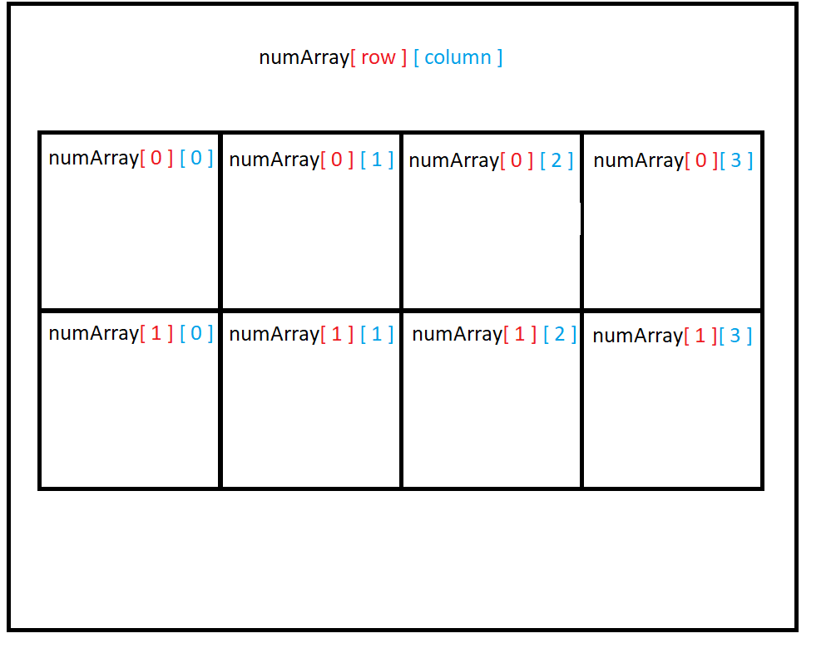
Order of iteration – by rows?
int[][] numArray = new int[2][4];
int rows = numArray.length;
int cols = numArray[0].length;
int count = 0;
for (int r = 0; r < rows; r++) {
for (int c = 0; c < cols; c++) {
numArray[r][c] = count;
count++;
} // end for
} // end for
0
1
2
3
4
5
6
7

Slide 44
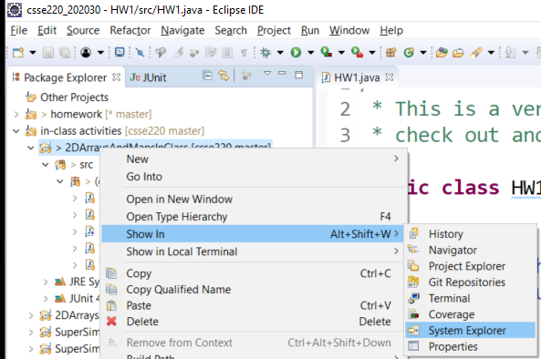
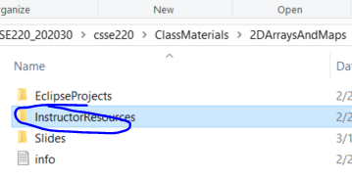
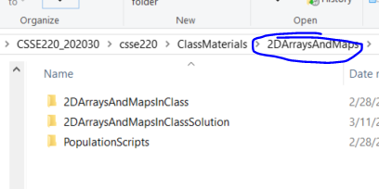
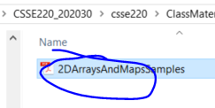
2D Arrays
1
3
4
2
Notes:
Once groups are finished, ask them to work on the array problems from SVN
Once enough groups are finished, review the quiz questions and refer students to the cheat sheet

Slide 45
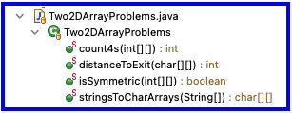
2D Arrays
Read through the 3 2D Array sample problems make sure you understand how they work
2DArraysAndMapsSamples.pdf – from Teams folder
Then use the code as an example to answer the 2D Array quiz questions (on Moodle)
Then do the 2d sample problems in the in-class exercise for today
Post ANY questions to Piazza even including code since this is purely collaborative exercise and the solution code is available to you
Please look to help answer questions other students post
Notes:
Once groups are finished, ask them to work on the array problems from SVN
Once enough groups are finished, review the quiz questions and refer students to the cheat sheet

Slide 46
Begin Maps Part of Today’s Discussion

Slide 47
Maps – What, When, Why, How?
What:
Collection of key-value pairs
Key is the identifier
i.e., A word in a dictionary, or a student ID number, something that uniquely identifies an item
Value is the data for that identifier
i.e., The definition of a word in a dictionary, a Student object for an ID, the value associated with a unique ID
Think of this like a dictionary (in some programming languages they’re even called dictionaries)
Key: word
Value: definition
Notes:
Example: counting the words in constitution, keep track of the occurrences of each word in the document
Each String should map to some integer!

Slide 48
Maps – What, When, Why, How?
When:
We use maps when a unique piece of data is used to retrieve additional information
Why:
Fast access to information based on a unique key
Example:
HashMap<String, Student>
usernameToStudent =
new HashMap<String, Student>();
Notes:
Draw table on the board showing username to students and attempt to look a student up by their username… if we had an ArrayList of students we’d have to loop through each and compare the username to find the student we wanted, but if we have them in a HashMap, we just have to look them up by their username. Makes the code simpler and faster
Angle brackets similar to?? ArrayList
HashMap very common. Has TWO TYPES? Why?

Slide 49
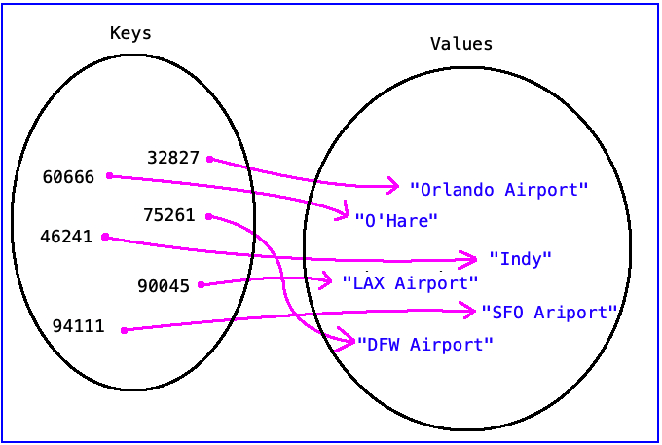
Another Example
HashMap<Integer, String>
airportMap = new HashMap<Integer, String>();
Keys = Integer = zipcode Values = String = Airport Name
Represented with a mathematical diagram:

Slide 50
Another Example
HashMap<Integer, String>
airportMap = new HashMap<Integer, String>();
Represented with a mathematical set:
airportToElevation = {
(46241, "Indy"),
(60666, "O'Hare"),
(32827, "Orlando Airport"),
(90045, "LAX Airport"),
(75261, "DFW Airport"),
(94111, "SFO Airport")
}
How Java prints it out to the Console window:
{46241=Indy, 60666=O'Hare, 32827=Orlando Airport, 90045=LAX Airport, 75261=DFW Airport, 94111=SFO Airport}

Slide 51
Maps
Sometimes, it’s difficult to fully understand maps.
Let’s do an example together:
Implement an int array using a map.
Notes:
For good measure, I will start this one from scratch just so they will see it from the ground up (I like them to see it from scratch sometimes, but it appears in the solution set).

Slide 52
Maps
Read through the 3 Map sample problems found in 2DArraysAndMapsSamples.pdf and make sure you understand how they work
Then use the code as an example to answer the Map quiz questions
Then solve the map problems in today’s code
Post ANY questions to Piazza even including code since this is purely collaborative exercise and the solution code is available to you
Please look to help answer questions other students post
Notes:
Once groups are finished, ask them to work on the array problems from SVN
Once enough groups are finished, review the quiz questions and pint class to the cheat sheet

Slide 53
HashMap with collections as values
What if we wanted to make a mini-social network…
Keep track of each student’s (username) friend list?
How could we store that information?
HashMap?
Type of key?
Type of value?
Code?

Slide 54
HashMap with collections as values
NULL POINTER EXCEPTION: friendMap is null
HashMap<String, ArrayList<String>> friendMap;
friendMap.put("Jason", new ArrayList<String>() );
friendMap = new HashMap<String, ArrayList<String>>();
friendMap.put("Jason", new ArrayList<String>() );
ArrayList<String> jasonsFriends = friendMap.get("Jason");
jasonsFriends.add("Aaron");
friendMap.get("Jason").add( "JP" );
friendMap.get("JP").add( "Jason" );
NULL POINTER EXCEPTION: friendMap.get("JP") is null
Keys (String) | Values (ArrayList<String> )
Keys (String) | Values (ArrayList<String> )
Jason | []
Keys (String) | Values (ArrayList<String> )
Jason | [Aaron]
Keys (String) | Values (ArrayList<String> )
Jason | [Aaron, JP]
friendMap->

Slide 55
Reminder: Questions from Today
Post ANY questions to Piazza even including code since this is purely collaborative exercise and the solution code is available to you
Please look to help answer questions other students post

Slide 56
Not necessary
Only use the following instructions if you have not imported everything on Day1

Slide 57
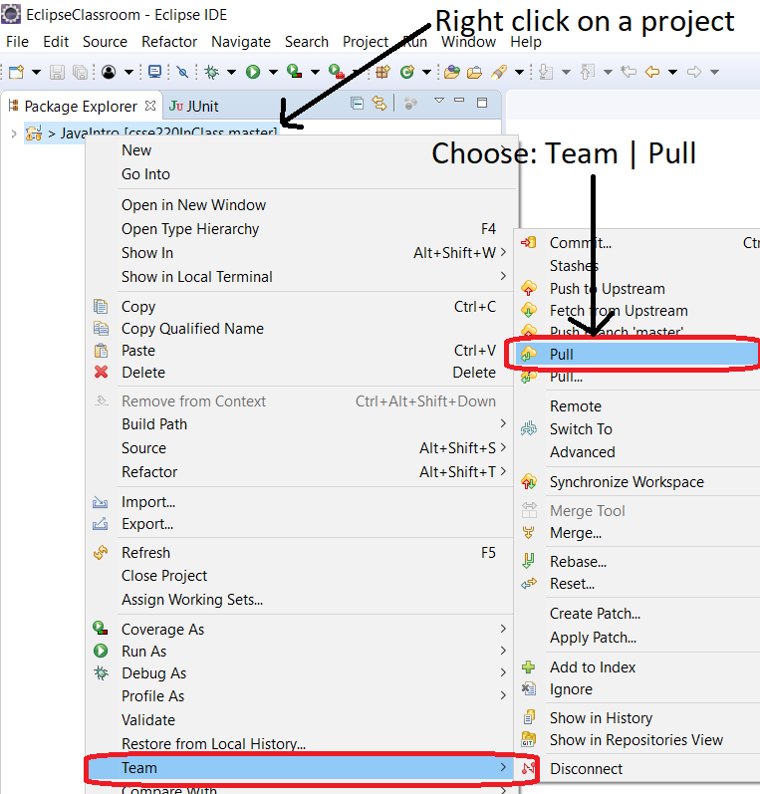
CSSE 220 – every class do this:
Pull Latest Version of Code/Slides
Team Pull

Slide 58
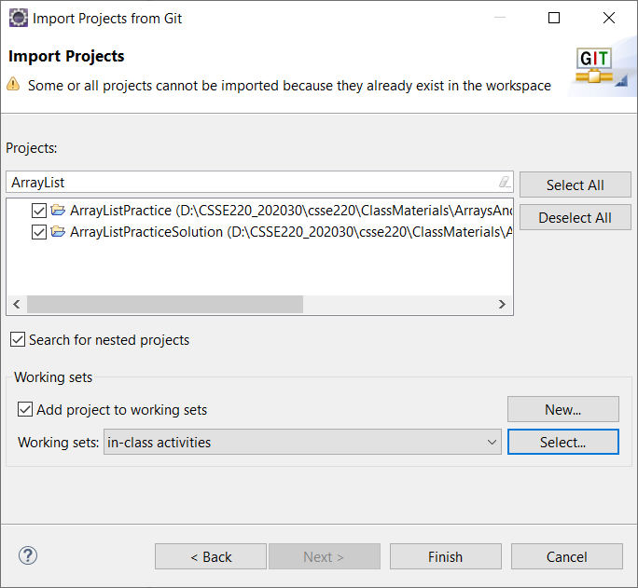
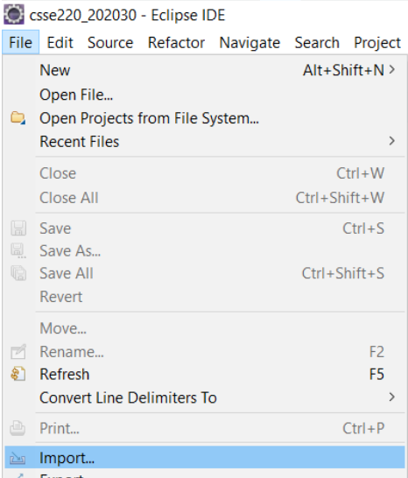
CSSE 220 – every class do this:
File->Import
Git->Projects from Git -> Next
Existing local repository -> Next
csse220 [master] ->Next
Import Existing Eclipse Projects->Next
**DESELECT ALL**
Search for repo name on slide:
Check projects for the day -> Finish
Import 2DArraysAndMapsInClass from Git repo

Slide 59
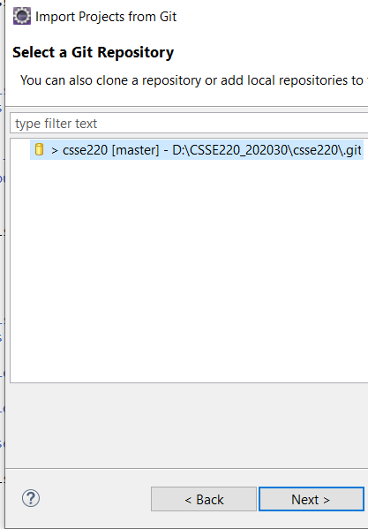
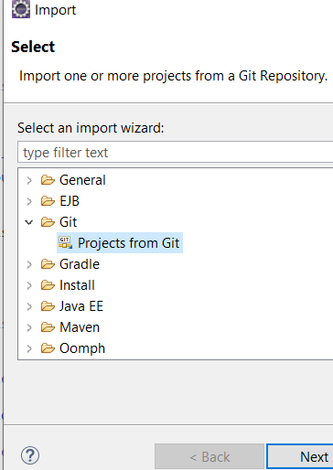
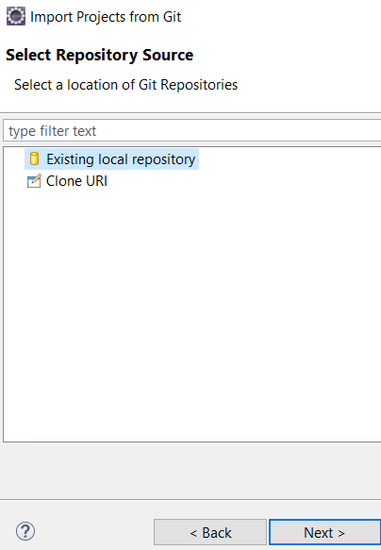
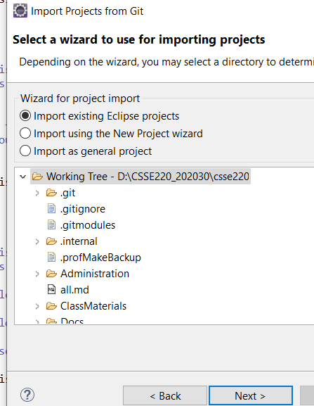
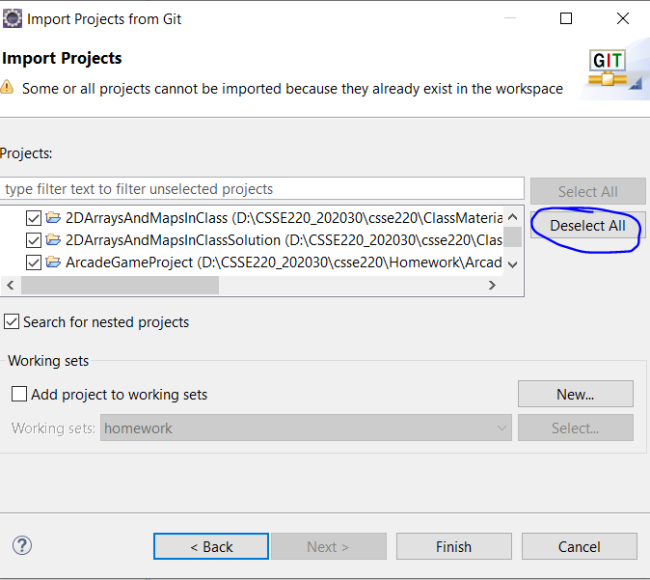
Screenshots

